Slide 1


Window Objects
Document Objects
BOM & DOM

Slide 2
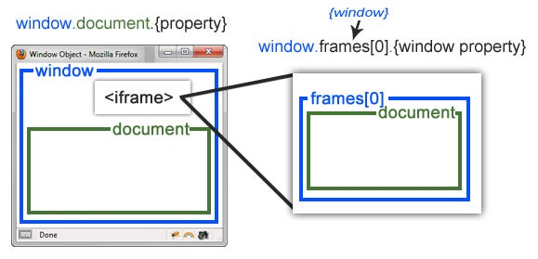
Overlook
The window object represents a window/tab containing a DOM document where as document object is property of window object that points to the DOM document loaded in that window.

Slide 3
Diffrence
WINDOW OBJECT | DOCUMENT OBJECT
It represent the browser window or a frame that display the content of the web page . | It represent any HTML document or web page that is loaded in the browser.
It is the very first object that is loaded in the Browser. | It is loaded inside the window.
It is the object of the Browser. | It is the object of window property.
Global objects , functions, and variable of java script are members of the window object. | All the tags elements with the attributes in HTML are part of the Document.
We can access the window from the window only . | We can access the document from a window using the window document.
Window is a part of BOM ., Not DOM . | The document is part od BOM (browser object Model) and DOM (Document object model).
Properties of window object cannot be accesed by document object. | Properties of document objects such as Title , Body ,Cookies, etc.. Can also be accesed by a window like this window document title.

